Slide 1
Happy Moments
Izzy Beers

Slide 2
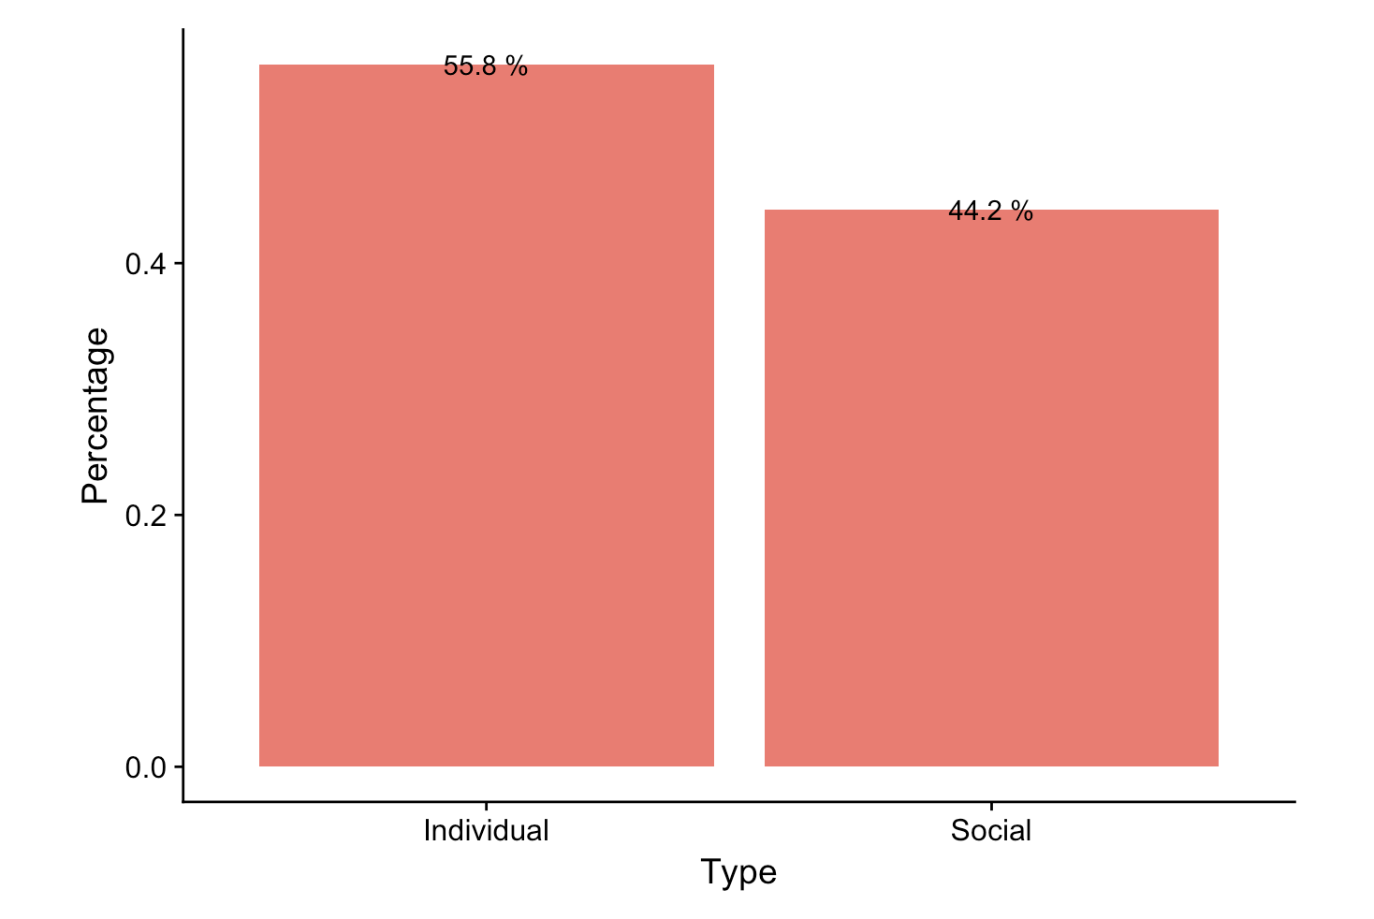
Social vs. Individual Moments
Classified a moment based on whether it was a social event or an individual event
Did this by coming up with a specific pattern for R to follow to reduce the number of false positives and false negatives
People experience countless moments every day, both individual and social, so what can we learn about the moments that people choose to report?

Slide 3
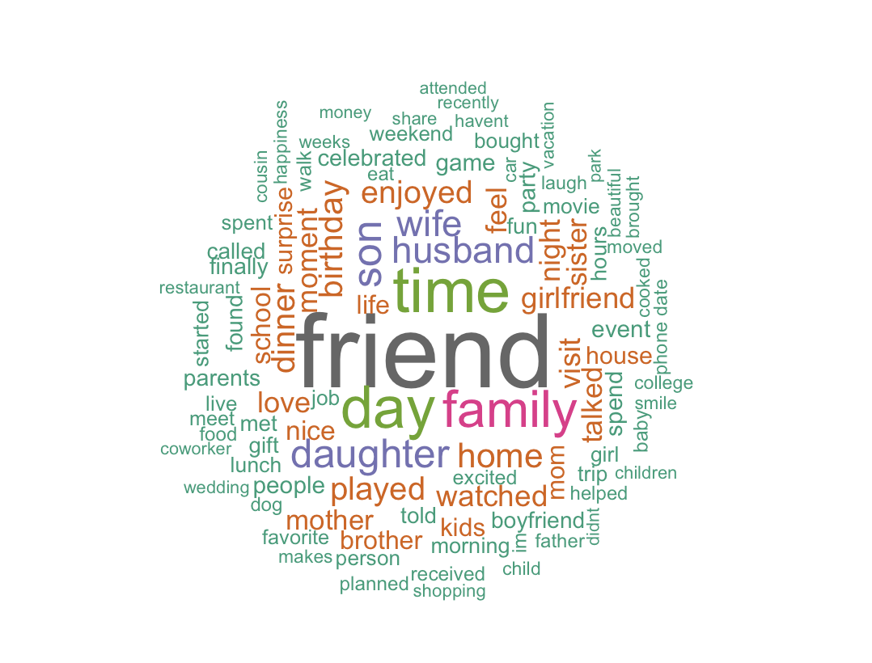
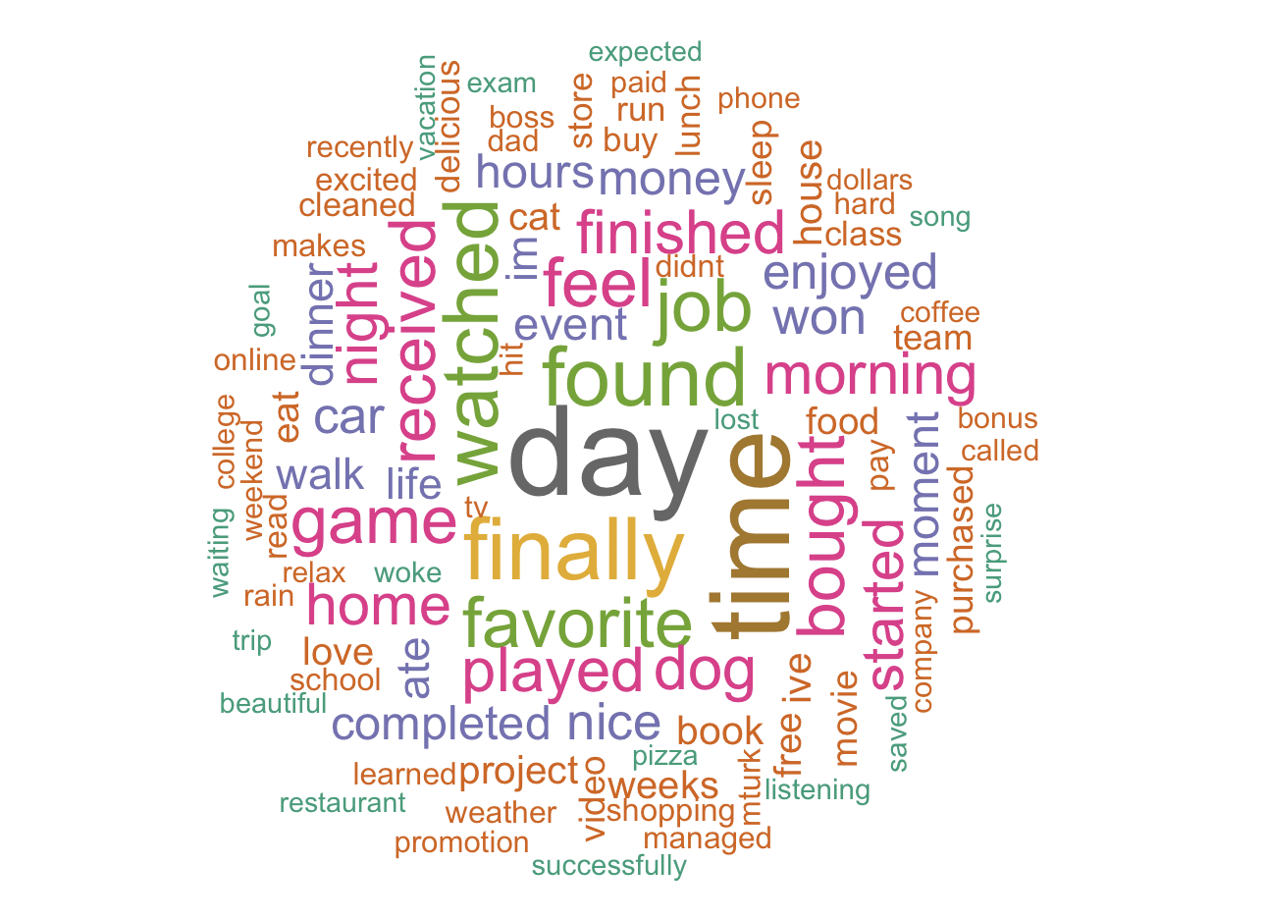
Most Common Social and Individual Words

Slide 4
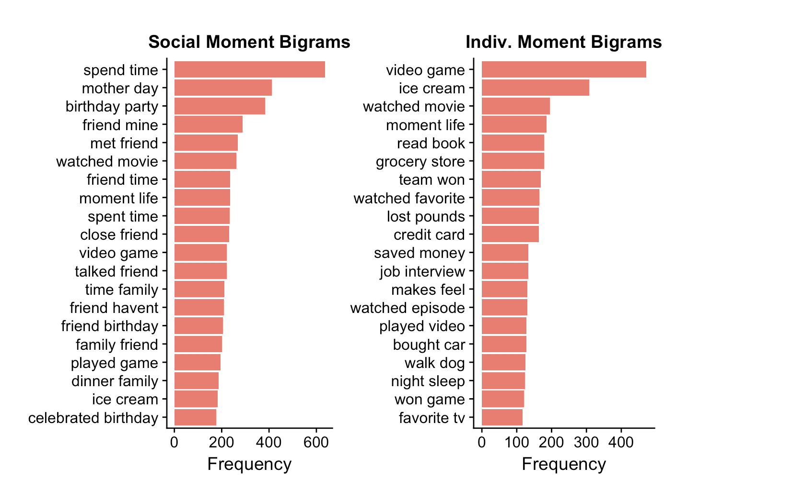
Most Common Social and Individual Bigrams

Slide 5
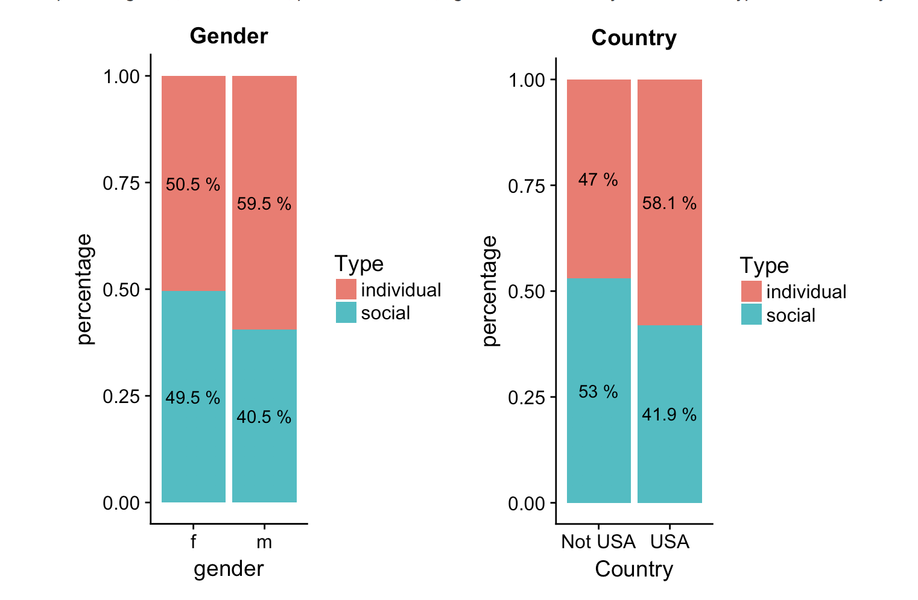
Gender and Country, and their relationship to Moment Type

Slide 6
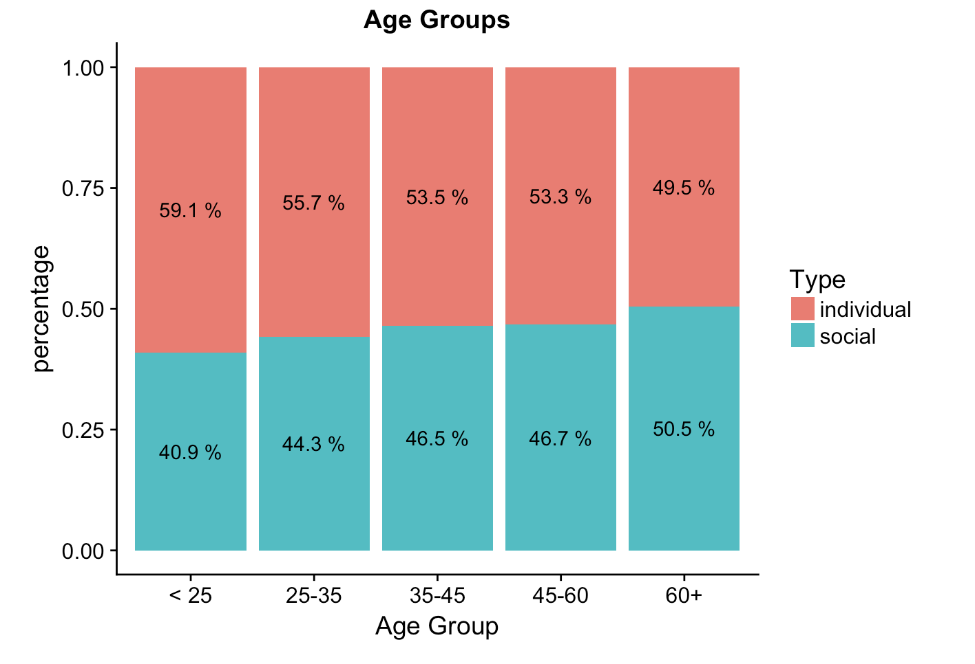
Age Group and its Relationship to Moment Type

Slide 7
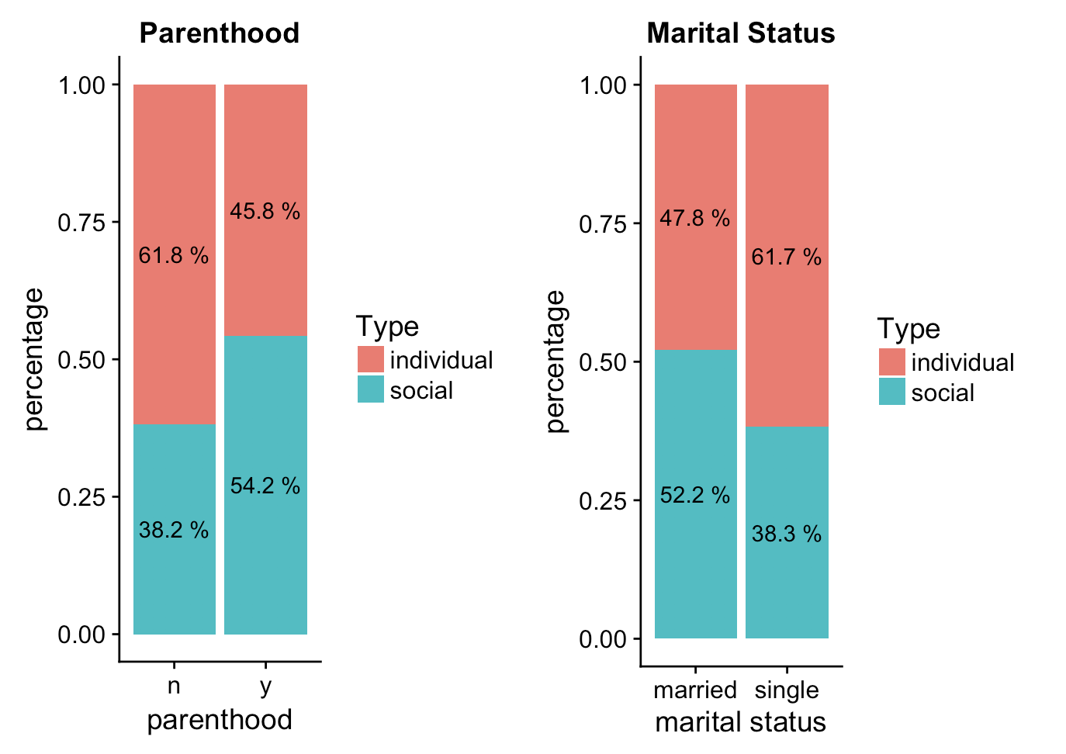
Parenthood and Marital Status, and Their Relationship to Moment Type
Note: these appear to be very similar to each other

Slide 8
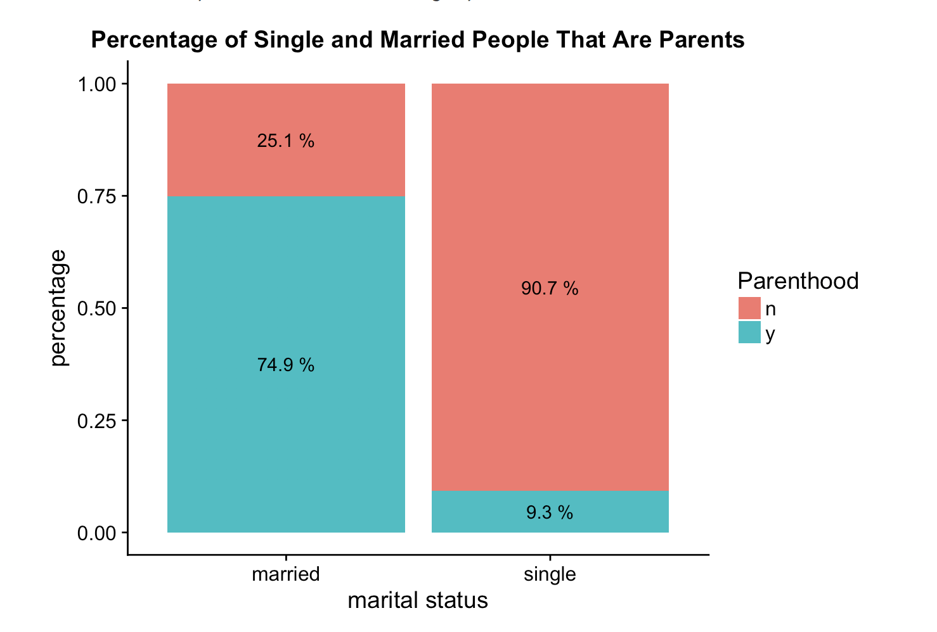
Is There An Overlap Between Parenthood and Marital Status?

Slide 9
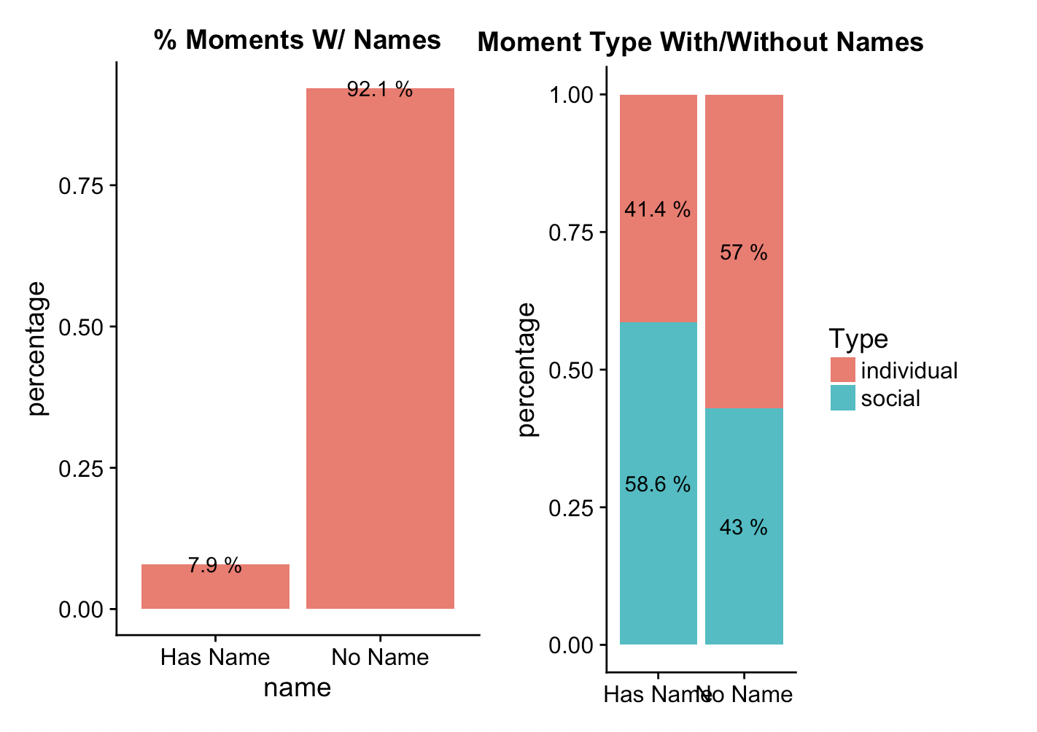
Moments With Names
Using a list of the 1000 most common boys and girls names, my text mining algorithm searched for moments with names in it
Why so many individual moments with names in it?

Slide 10
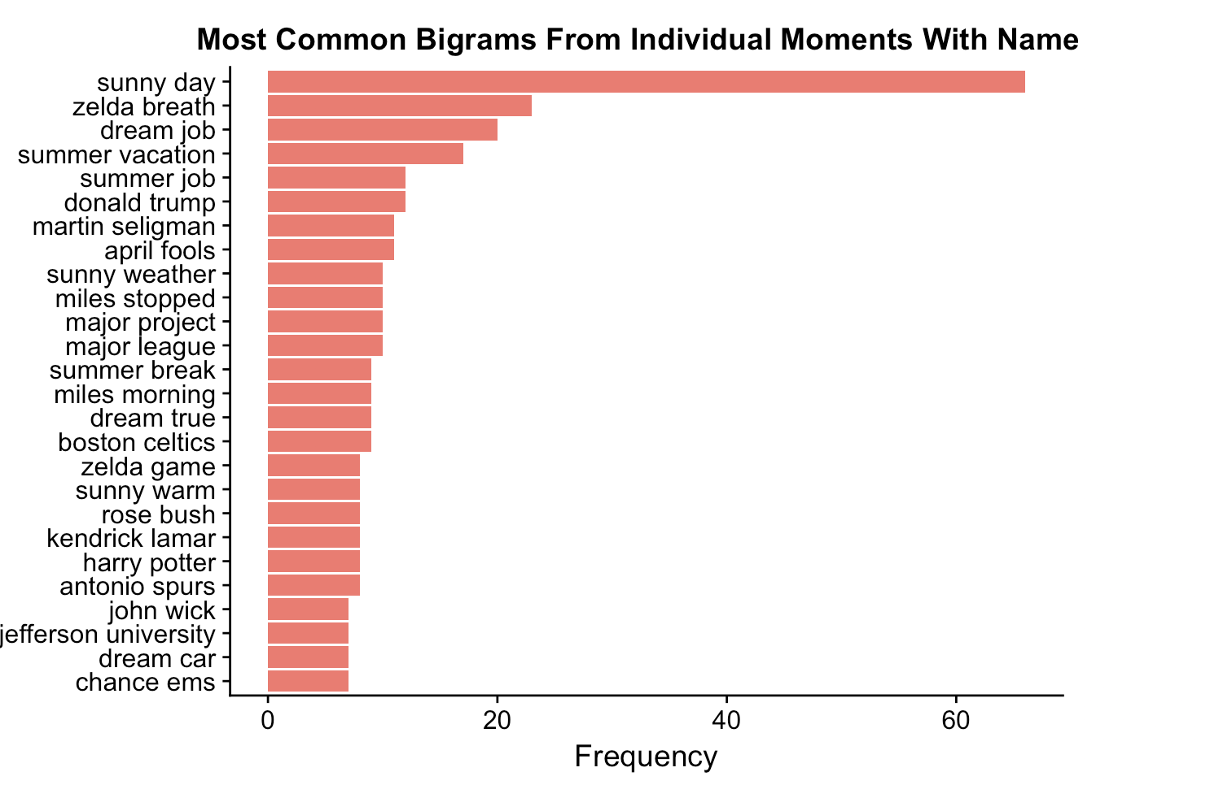
The most frequent non-social uses of names
Some names are everyday words:
Sunny day
Summer vacation
Major league
April fools
Rose bush
Company names (not on this graph, but in dataset):
Ben and Jerry’s
Jack in the Box
Famous people references:
Kendrick Lamar
Donald Trump
Movies/Games:
Harry Potter
John Wick
Zelda Breath

Slide 11
Conclusion
Approximately 56% of moments were individual, 44% were social
Groups more likely to report a social moment:
Females
Parents
Married People
Older People
People who don’t live in USA
People only used a person’s name in their moment 7.9% of the time
Out of these, only about 60% were social
In the individual moments, these names were either used everyday words, celebrity references, company names, movie/game names, and other non-social references

